Slide 1
Support Vector Machines

Slide 2
Support Vector Machine (SVM) is a Supervised Machine Learning Algorithm used for classification and/or regression.
Basically, SVM finds a hyper-plane that creates a boundary between the types of data.
In 2-dimensional space, this hyper-plane is nothing but a line.
In SVM, we plot each data item in the dataset in an N-dimensional space, where N is the number of features/attributes in the data.
Next, find the optimal hyperplane to separate the data.

Slide 3
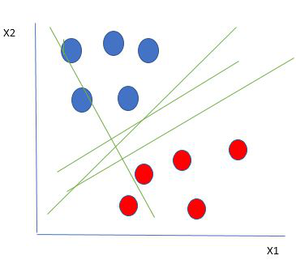
Let’s consider two independent variables x1, x2 and one dependent variable which is either a blue circle or a red circle.
So how do we choose the best line or in general the best hyperplane that segregates our data points.

Slide 4
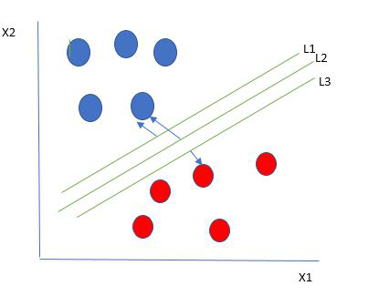
Selecting the best hyper-plane:
One reasonable choice as the best hyperplane is the one that represents the largest separation or margin between the two classes.
So we choose the hyperplane whose distance from it to the nearest data point on each side is maximized.
If such a hyperplane exists it is known as
the maximum-margin hyperplane/hard margin.

Slide 5
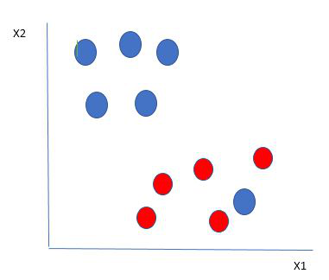
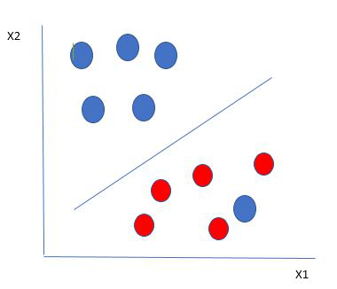

Slide 6
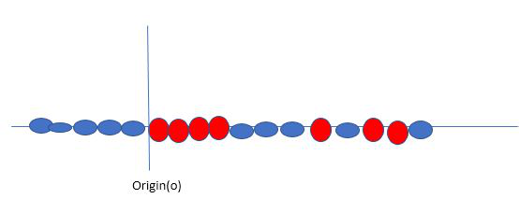
Non linear separable data
SVM solves this by creating a new variable using a kernel. We call a point x_{i} on the line and we create a new variable y_{i} as a function of distance from origin o.

Slide 7
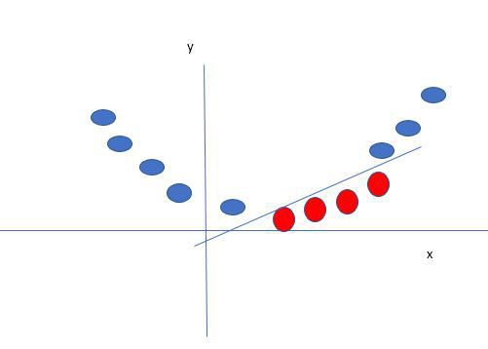
The SVM kernel is a function that takes low dimensional input space and transforms it into higher-dimensional space, ie it converts not separable problem to separable problem.
It is mostly useful in non-linear separation problems.

Slide 8
Gaussian Kernel
Gaussian Kernel Radial Basis Function (RBF)
Sigmoid Kernel
Polynomial Kernel
Linear Kernel

Slide 9
SVM implementation in python:
Objective: Predict if cancer is benign or malignant.
Using historical data about patients diagnosed with cancer, enable the doctors to differentiate malignant cases and benign given the independent attributes.

Slide 10
Exercise
Use IRIS dataset and classify using SVM

